Slide 1
Oligopoly and Strategic Behavior
1

Slide 2
Topics to be covered:
Structure of the Oligopoly Market
Collusive and Non- Collusive Oligopoly
Cartels
Short-run Price and Output determination
Long-run Price and Output determination
Resources that can be consulted:
H. C. Petersen, W. C. Lewis and S. K. Jain, Managerial Economics, 4th ed., Pearson Education 2006.
D. Salvatore, Managerial Economics in a Global Economy, 8th ed., Thomson Asia, 2015.
R. H. Frank, Microeconomics and Behavior, 7th ed., Mc-Graw Hill Irwin, 2008
Keat, P., Young, P., & Erfle, S.,Managerial economics: Economic tools for today’s decision makers (7 th ed.) Upper Saddle River, NJ: Prentice Hall, 2014
2

Slide 3
Oligopoly -Characteristics
Few sellers of a product
Duopoly - Two sellers
Pure oligopoly - Homogeneous product
Differentiated oligopoly - Differentiated product
Non-price competition
Barriers to entry
High degree of interdependence between firms
Abnormal profits
Potential for collusion
3

Slide 4
Measuring Market Concentration
Concentration ratio: the percentage of the market’s total output supplied by the largest firms (usually the four largest).
The higher the concentration ratio, the less competition.
4

Slide 5
Concentration Ratios in Selected U.S. Industries¹
0
Industry | Concentration ratio
Video game consoles | 100%
Tennis balls | 100%
Credit cards | 99%
Batteries | 94%
Soft drinks | 93%
Web search engines | 92%
Breakfast cereal | 92%
Cigarettes | 89%
Greeting cards | 88%
Beer | 85%
Cell phone service | 82%
Autos | 79%
5
Notes:
5
Sources: U.S. Census Bureau (www.census.gov), Federal Trade Commission (www.ftc.gov), and various periodicals and microeconomics textbooks.

Slide 6
Models of Oligopoly Behavior
No single general model of oligopoly behavior exists.
Stackelberg Model
Bertrand Model
Cournot Model
Sweezy (Kinked-Demand) Model
6

Slide 7

Stackelberg Model
The Stackelberg leadership model is a strategic game in economics in which the leader firm moves first and then the follower firms move sequentially.
7

Slide 8

Bertrand Model
The Bertrand duopoly model examines price competition among firms that produce differentiated but highly substitutable products.
8

Slide 9
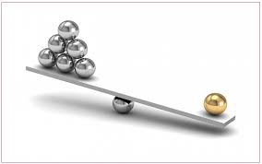
Cournot Model
Cournot competition describes a market structure in which companies compete on the amount of output they will produce, which they decide on independently of each other and at the same time.
9

Slide 10
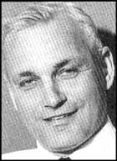
Kinked Demand Curve Model²
Proposed by Paul Sweezy
If an oligopolist raises price, other firms will not follow, so demand will be elastic
If an oligopolist lowers price, other firms will follow, so demand will be inelastic
Implication is that demand curve will be kinked, MR will have a discontinuity, and oligopolists will not change price when marginal cost changes
10

Slide 11
Price
Kinked Demand Curve
Rs 5
D = elastic
Kinked D Curve
D = Inelastic
100
Quantity
11

Slide 12
MC’
MC
MC’’
12

Slide 13
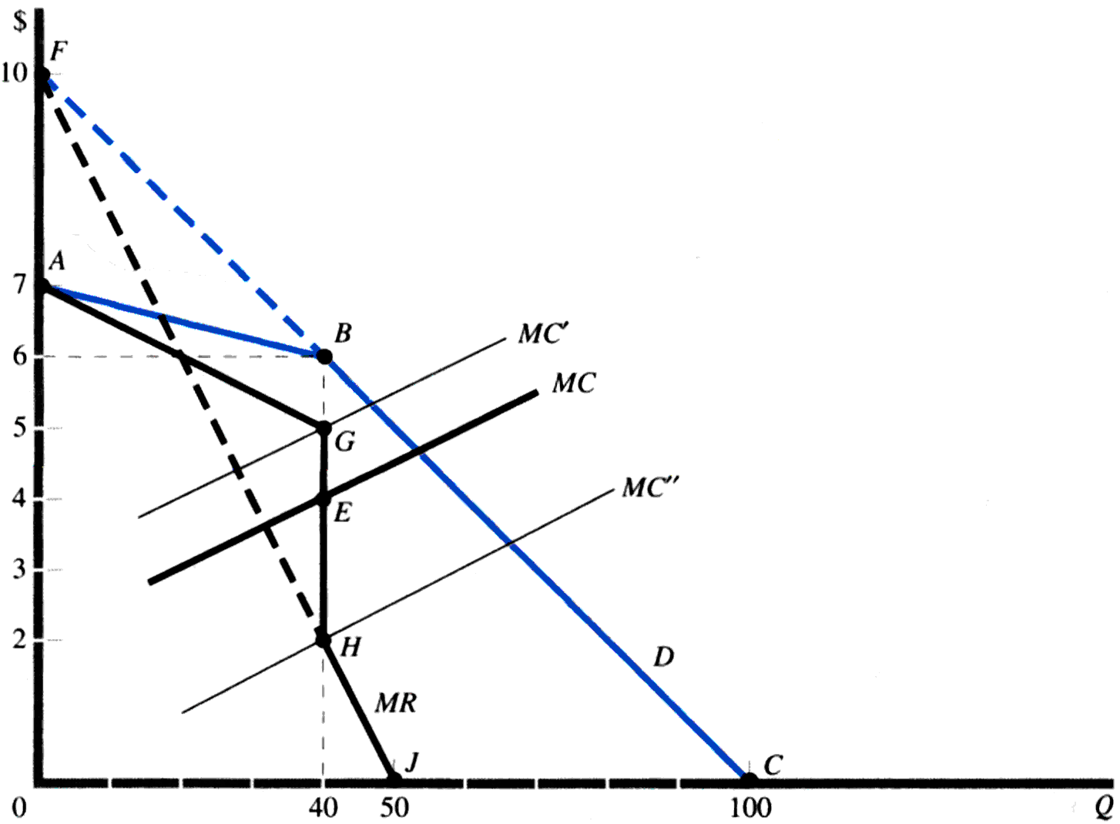
Kinked Demand Curve Model
13

Slide 14
Criticism
No evidence that price increase is not matched.
Unable to tell the price at which the kink will occur.
14

Slide 15
Cartels
Collusion
When a small number of firms share a market, they can increase their profit by forming a cartel and acting like a monopoly.
Collusion can be: overt or explicit and tacit or implicit
Explicit collusion is called cartel. It is a group of firms acting together to limit output, raise price, and increase economic profit. For example, Mumbai Taxi Association, OPEC etc.
Implicit collusions are known as price leadership models.
Collusions are illegal but they do operate in some markets.
15

Slide 16
Cartels
Market-Sharing Cartel
Collusion to divide up markets on the basis of geographical area
Centralized Cartel
Formal agreement among member firms to set a monopoly price and allocate output among its members and determine how profits are to be shared.
Example: OPEC
16

Slide 17
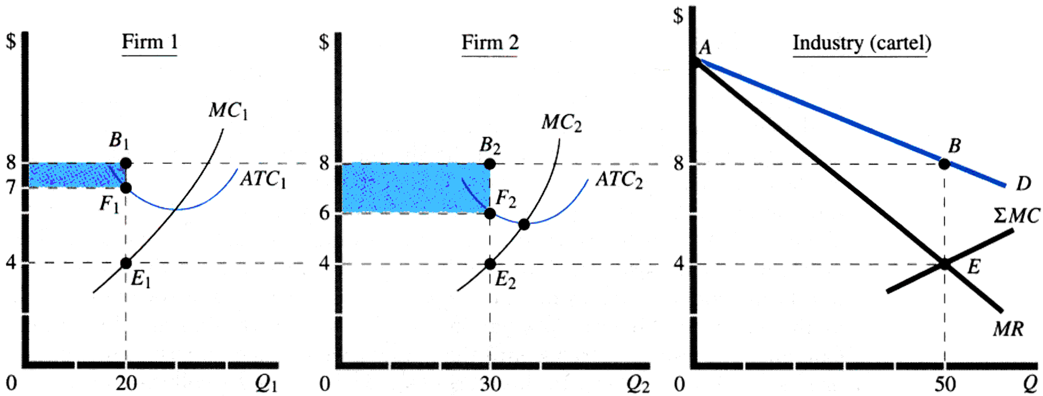
Centralized Cartel³
17

Slide 18
Weakness
Firms can ask for an equitable distribution of profits.
Cartel members have a strong incentive to cheat by selling more.
Monopoly profits may attract other firms.
18

Slide 19
Oligopoly vs. Other Market Structures
Oligopoly presents the greatest challenge to economists
essence of oligopoly is strategic interdependence
economists have had to modify the tools used to analyze other market structures and to develop entirely new tools as well
One approach—game theory—has yielded rich insights into oligopoly behavior
19

Slide 20
ROLE OF THE COMPETITION COMMISSION OF INDIA
The Competition Commission of India is a body of the government of India that is responsible for enforcing the Competition Act 2012.
This act is there to prevent activities that have an adverse effect on competition and was established in October 2003. The Competition Act, 2002, as amended by the Competition (Amendment) Act, 2007, follows the philosophy of modern competition laws.
The act prohibits anti-competitive agreements, abuse of dominant position by enterprises and regulates combinations, which cause or are likely to cause an appreciable adverse effect on competition within India
20

Slide 21

21

Slide 22
The price of Kajuroll is currently at Rs 400 per kg. Kamath sweets faces a kinked demand curve with a demand equation P= 600- 0.5Q for prices above Rs 400 and
P= 700- 0.75Q for prices below Rs 400. The firm’s marginal cost surve is given by an equation with the general form
MC= a + bQ
If a=50 and b= 0.25, graph the demand , MR and MC curves.
Determine the profit-maximizing output.
Starting from a=50, how much can the constant term of the marginal cost equation increase before the profit-maximising quantity decreases? How much can the coefficient decrease before the profit maximizing quantity increases?
22

Slide 23
In an oligopolistic industry, the other firms do not respond to changes in price of a firm’s product, the demand curve is Q= 700-50P. However, if other firms always match the firm’s price , the demand curve is Q = 200-10P.
Calculate profit maximizing quantity and price-
If MC= 8.00
If MC= 11.50
23

Slide 24
References
https://www.chegg.com/homework-help/questions-and-answers/product-concentration-ratio-100-100-100-100-99-99-98-98-98-98-video-game-consoles-instant--q51070465
H. C. Petersen, W. C. Lewis and S. K. Jain, Managerial Economics, 4th ed., Pearson Education 2006.
H. C. Petersen, W. C. Lewis and S. K. Jain, Managerial Economics, 4th ed., Pearson Education 2006.
https://economictimes.indiatimes.com/news/economy/policy/india-breaks-potash-cartel-to-save-rs-5k-cr/articleshow/4809980.cms?from=mdr
24

Slide 25
MCQs
1. Which of the following statements is true for both monopolistically competitive and oligopolistic industries?
a.It is impossible for new firms to enter the industries.
b.Collusion and the creation of cartels is common.
c.Producers cannot benefit from knowing other firms' plans.
d. Firms have some degree of control over prices
2. Which of the following is not a characteristic of an oligopolistic market?
a. Firms are often drawn into game playing situations
b. Firms consider the possible reactions of rivals
c. Entry is relatively easy
d. There are a few sellers of a good or service
25

Slide 26
3.Collusion most frequently occurs in industries that are
Oligopolistic
monopolistically competitive
monopolistic
perfectly competitive
4. . If a few firms share most of an entire industry's revenues, the market structure is most likely
monopolistically competitive
an oligopoly
perfectly competitive
a monopoly
5. The harmful effects of oligopoly include all of the following
a. Economies of scale result in a small number of large firms that spend more of research and development.
b. Price is greater than long-run marginal and average cost.
c. Production does not generally take place at the lowest point on the long-run average cost curve.
d. All of the above are harmful effects of oligopoly.
Answers: 1.d 2.c 3. a 4.b 5. a
26

